Slide 1

Reproducible Research with R and RStudio
Notes:
Welcome to the workshop

Slide 2
Welcome to the Tidyverse
Notes:
Welcome to the workshop

Slide 3

Your Turn
Form groups of 2-4 people. Introduce yourself to your group members. Tell them:
Who you are
What you do with data
How long you have been using R
Notes:
But the most important people you will be working with today are seated right beside you

Slide 4
HELLO
my name is
Garrett
 @StatGarrett
Notes:
My name is Garrett. I'm a Data Scientist who works for RStudio, the company that makes all of the free software that we're going to use today.

Slide 5
HELLO
my name is
Carl
Notes:
My name is Garrett. I'm a Data Scientist who works for RStudio, the company that makes all of the free software that we're going to use today.

Slide 6
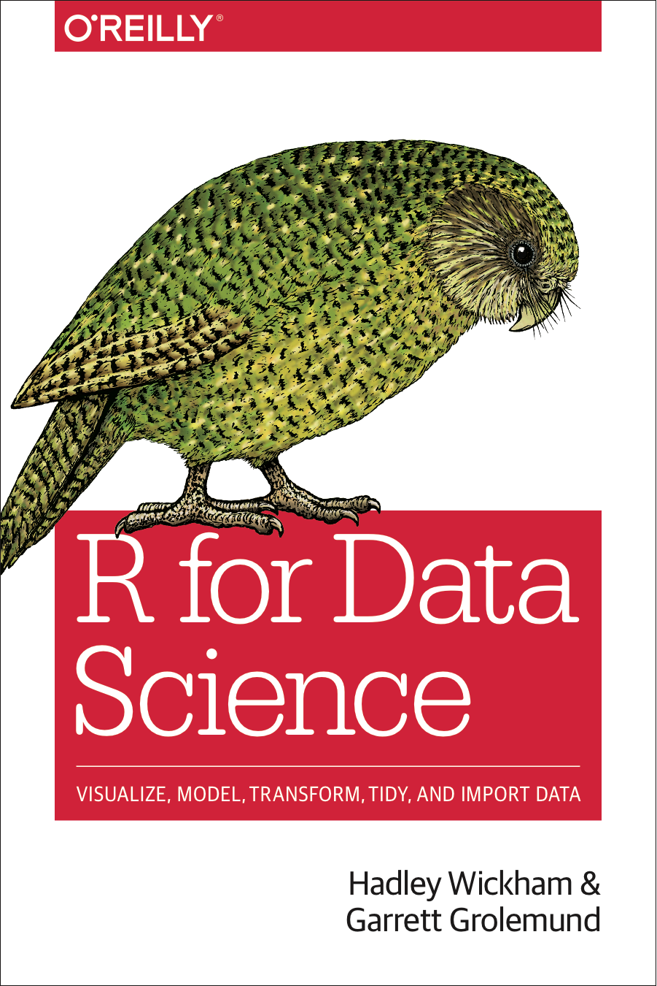
Notes:
I've written several books on the R language including, R for Data Science, which this workshop will be loosely based around.

Slide 7

Pop Quiz
What does IMRAD stand for? Poll your neighbors.
Introduction
What hypothesis was tested and why?
Methods
How was the study done?
Results
What answer was discovered?
And Discussion
What does the answer imply?
Notes:
IMRAD is an agreed upon convention for making scientific work reproducible. Why is that important? Let's do a thought experiment.

Slide 8
Which words do you associate with math?
hypotheses
axioms
messy
logical
best guess
certain
discover
prove
CC BY-SA RStudio
Notes:
Think in your head: which group of words do you associate with Math?
Its probably not "hypotheses, messy, best guess, and discover." Well maybe it is if you're very new to math, or very advanced. But the beauty of math is that it is so precise, and so logically certain. In math, you can prove things. Thats why we like to use it when we can.

Slide 9
Which words do you associate with Science?
hypotheses
axioms
messy
logical
best guess
certain
discover
prove
CC BY-SA RStudio
Notes:
Now think of science. Science is messy, and exploratory. You never prove anything, you are always working with hypotheses that represent your best guesses. Your road to glory lies in discovering something that no one else has documented before.
The two systems are complementary. Like all logic systems, math can only reveal information that is already contained in the definitions of things. In math's case the definitions are the definitions of numbers or numerical models. But math cannot tell you if those definitions correspond to reality. That's what science is for. Science identifies the most pragmatic definitions to use, the ones that seem to best match reality, but those definitions will always be an estimate. Science cannot prove anything.

Slide 10


Create maps, not proofs
IMRAD
Notes:
So how do we fix science? We have an easy model to follow. During the age of exploration, navigators attempted to discover and document unknown corners of the world. This is exactly what scientists do.
Think of Christopher Columbus as an example. When Columbus discovered the New World, he didn't return to Spain and justify his discovery with some type of logical test. Instead, he provided a map for other explorers to follow. If they followed the map and it led to where Columbus said it did, then the discovery spoke for itself. On the other hand, if they followed the map and it did not lead to where Columbus claimed, that too would speak for itself.
Like Columbus, good scientists create maps for others to follow, not proofs. We are looking for real things that will speak for themselves, so long as we show others how to find them.

Slide 11
(Experimental) Science
IMRAD
Experiment
Data
Hypothesis
Conclusions
CC BY-SA RStudio
Notes:
In many ways, scientists have always known this. Scientists have a very robust culture for making maps that lead from hypotheses to data. Many scientific articles comprise just this type of map. This system worked very well when data was nearly synonymous with conclusion.
But in the age of data scientists, scientists must follow a chain of reasoning to get from the data to conclusions, and scientists do not provide good maps to lead others through this reasoning.
Part of the difficulty is the number of things that a useable map would need to include. The map would need to include the data collected, the code used to analyze the data, the software used to run the code, and the reasoning that guided the whole process and interpreted the results.

Slide 12
Pop Quiz
What is data science? Poll your neighbors.
Notes:
IMRAD is an agreed upon convention for making scientific work reproducible. Why is that important? Let's do a thought experiment.

Slide 13
Pop Quiz
What is data science? Poll your neighbors.
Science with non-trivial data?
Notes:
IMRAD is an agreed upon convention for making scientific work reproducible. Why is that important? Let's do a thought experiment.

Slide 14
Data Science
Experiment
Data
Hypothesis
Conclusions
CC BY-SA RStudio
Notes:
In many ways, scientists have always known this. Scientists have a very robust culture for making maps that lead from hypotheses to data. Many scientific articles comprise just this type of map. This system worked very well when data was nearly synonymous with conclusion.
But in the age of data scientists, scientists must follow a chain of reasoning to get from the data to conclusions, and scientists do not provide good maps to lead others through this reasoning.
Part of the difficulty is the number of things that a useable map would need to include. The map would need to include the data collected, the code used to analyze the data, the software used to run the code, and the reasoning that guided the whole process and interpreted the results.

Slide 15
Data Science
Data
Data
Experiment
Visualize
Transform
Model
Hypothesis
Conclusions
CC BY-SA RStudio
Notes:
In many ways, scientists have always known this. Scientists have a very robust culture for making maps that lead from hypotheses to data. Many scientific articles comprise just this type of map. This system worked very well when data was nearly synonymous with conclusion.
But in the age of data scientists, scientists must follow a chain of reasoning to get from the data to conclusions, and scientists do not provide good maps to lead others through this reasoning.
Part of the difficulty is the number of things that a useable map would need to include. The map would need to include the data collected, the code used to analyze the data, the software used to run the code, and the reasoning that guided the whole process and interpreted the results.

Slide 16
Data Science
Import
Tidy
Data
Visualize
Transform
Experiment
Model
Hypothesis
Conclusions
CC BY-SA RStudio
Notes:
In many ways, scientists have always known this. Scientists have a very robust culture for making maps that lead from hypotheses to data. Many scientific articles comprise just this type of map. This system worked very well when data was nearly synonymous with conclusion.
But in the age of data scientists, scientists must follow a chain of reasoning to get from the data to conclusions, and scientists do not provide good maps to lead others through this reasoning.
Part of the difficulty is the number of things that a useable map would need to include. The map would need to include the data collected, the code used to analyze the data, the software used to run the code, and the reasoning that guided the whole process and interpreted the results.

Slide 17
Data Science
Reasoning
Import
Data
Tidy
Data
CODE
Visualize
?
Transform
Experiment
Model
Hypothesis
Conclusions
CC BY-SA RStudio
Notes:
In many ways, scientists have always known this. Scientists have a very robust culture for making maps that lead from hypotheses to data. Many scientific articles comprise just this type of map. This system worked very well when data was nearly synonymous with conclusion.
But in the age of data scientists, scientists must follow a chain of reasoning to get from the data to conclusions, and scientists do not provide good maps to lead others through this reasoning.
Part of the difficulty is the number of things that a useable map would need to include. The map would need to include the data collected, the code used to analyze the data, the software used to run the code, and the reasoning that guided the whole process and interpreted the results.

Slide 18
Data Science
Communicate
Import
Tidy
Data
Visualize
Transform
Experiment
Model
Hypothesis
Conclusions
CC BY-SA RStudio
Notes:
In many ways, scientists have always known this. Scientists have a very robust culture for making maps that lead from hypotheses to data. Many scientific articles comprise just this type of map. This system worked very well when data was nearly synonymous with conclusion.
But in the age of data scientists, scientists must follow a chain of reasoning to get from the data to conclusions, and scientists do not provide good maps to lead others through this reasoning.
Part of the difficulty is the number of things that a useable map would need to include. The map would need to include the data collected, the code used to analyze the data, the software used to run the code, and the reasoning that guided the whole process and interpreted the results.

Slide 19
Data Science
Communicate
Import
Tidy
Data
Visualize
Transform
Experiment
Model
Program
Hypothesis
Conclusions
CC BY-SA RStudio
Notes:
In many ways, scientists have always known this. Scientists have a very robust culture for making maps that lead from hypotheses to data. Many scientific articles comprise just this type of map. This system worked very well when data was nearly synonymous with conclusion.
But in the age of data scientists, scientists must follow a chain of reasoning to get from the data to conclusions, and scientists do not provide good maps to lead others through this reasoning.
Part of the difficulty is the number of things that a useable map would need to include. The map would need to include the data collected, the code used to analyze the data, the software used to run the code, and the reasoning that guided the whole process and interpreted the results.

Slide 20
(Applied) Data Science
Visualize
Import
Tidy
Model
Communicate
Transform
Program
Notes:
We'll start with visualizing data. I need everyone to be able to visualize their data with confidence. This will make it easier to understand what we're doing when we start transforming data later in the workshop.

Slide 21
Visualize
Import
Tidy
Model
Reason
Communicate
Transform
Program
e.g.
infer/test
predict
hedge
interpret/connect
Notes:
We'll start with visualizing data. I need everyone to be able to visualize their data with confidence. This will make it easier to understand what we're doing when we start transforming data later in the workshop.

Slide 22
Outline
Introduction and Visualize Data | 8:30 - 10:15
Morning Break | 10:15 - 10:30
Transform Data | 10:30 - 12:30
Lunch | 12:30 - 2:00
Model Data | 2:00 - 3:15
Afternoon Break | 3:15 - 3:30
Reproducible Reporting | 3:30 - 5:00

Slide 23
R and RStudio
Notes:
Raise your hand if you know what an R package is (do or skip the next slide according to the results)

Slide 24

Your Turn
Go here and log in for the class materials
https://rstudio.cloud/project/385945

Slide 25
Demo

Slide 26

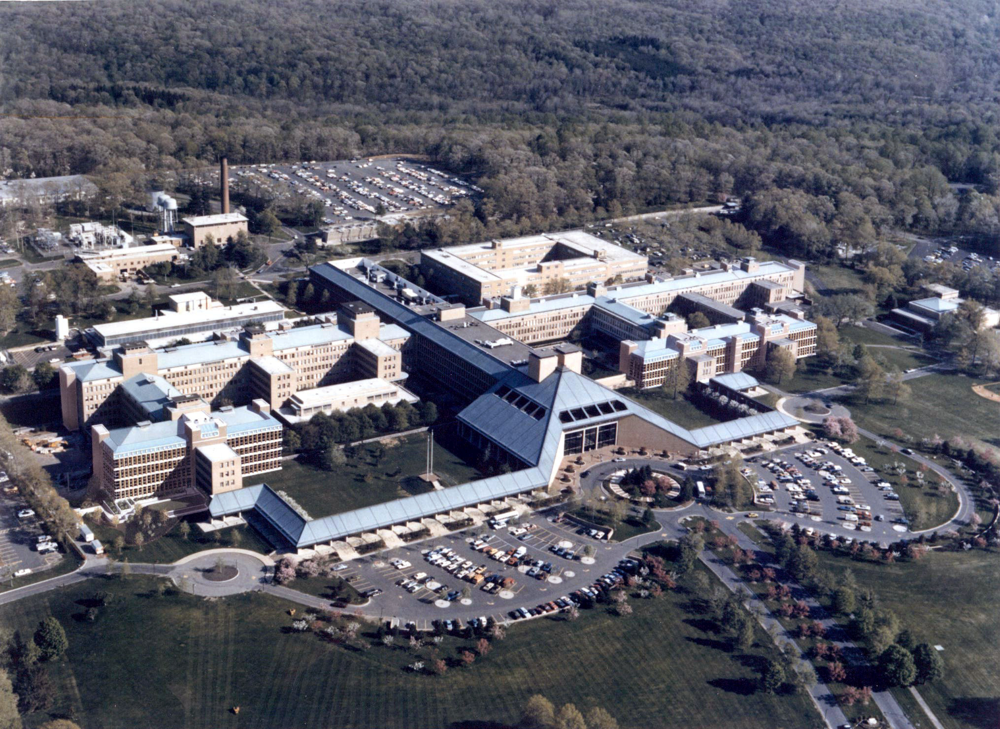
https://rstudio.cloud/project/385945
User friendly
Designed for data science
Designed to run other languages
A language

Slide 27

https://rstudio.cloud/project/385945
A language
Writing software

Slide 28
Buy products
that facilitate
use of OSS
Contributes
Open Source
Software (OSS)
Sells
products
Commercial
Customers
Data Science
Community
Drives adoption of OSS

Slide 29
Buy products
that facilitate
use of OSS
Contributes
Open Source
Software (OSS)
Sells
products
Commercial
Customers
Data Science
Community
Drives adoption of OSS

Slide 30
R the language
Values - 1, "Florida", "2010-01-25"

Slide 31
R the language
Values - 1, "Florida", "2010-01-25"
Objects - x <- 22/7
A value, object, or function result
A name without quotes
< followed by -
(it looks like an arrow)

Slide 32
R the language
Values - 1, "Florida", "2010-01-25"
Objects - x <- c(22/7, 0.99, 3)
To put multiple values in an object, combine the values with c()

Slide 33
R the language
Values - 1, "Florida", "2010-01-25"
Objects - x <- c(22/7, 0.99, 3)
Functions - round(x, digits = 3)
A name without quotes
followed by () to run the function
Arguments: values, objects, or function results

Slide 34
Warm Up
Which of these are numbers?
1
"1"
"one"
one

Slide 35
Warm Up
Which of these are numbers?
1
"1"
"one"
one
number

Slide 36
Warm Up
Which of these are numbers?
1
"1"
"one"
one
number
words (strings)

Slide 37
Warm Up
Which of these are numbers?
1
"1"
"one"
one
number
words (strings)
object

Slide 38
Warm Up
Which of these will work? Suppose one <- 1.
log(1)
log("1")
log("one")
log(one)

Slide 39
Warm Up
Which of these will work? Suppose one <- 1.
log(1)
log("1")
log("one")
log(one)

Slide 40
R Markdown
Notes:
Okay. That was the longest you will hear me lecture all day! From here out, you guys take the lead. Now you know all the pre-requisite minutiae to get started. Let's start writing some code.

Slide 41

Your Turn
Go to 01-Introduction.
Open 01-RMarkdown-Exercises.Rmd. Read through the file and do everything it tells you to do.

Slide 42
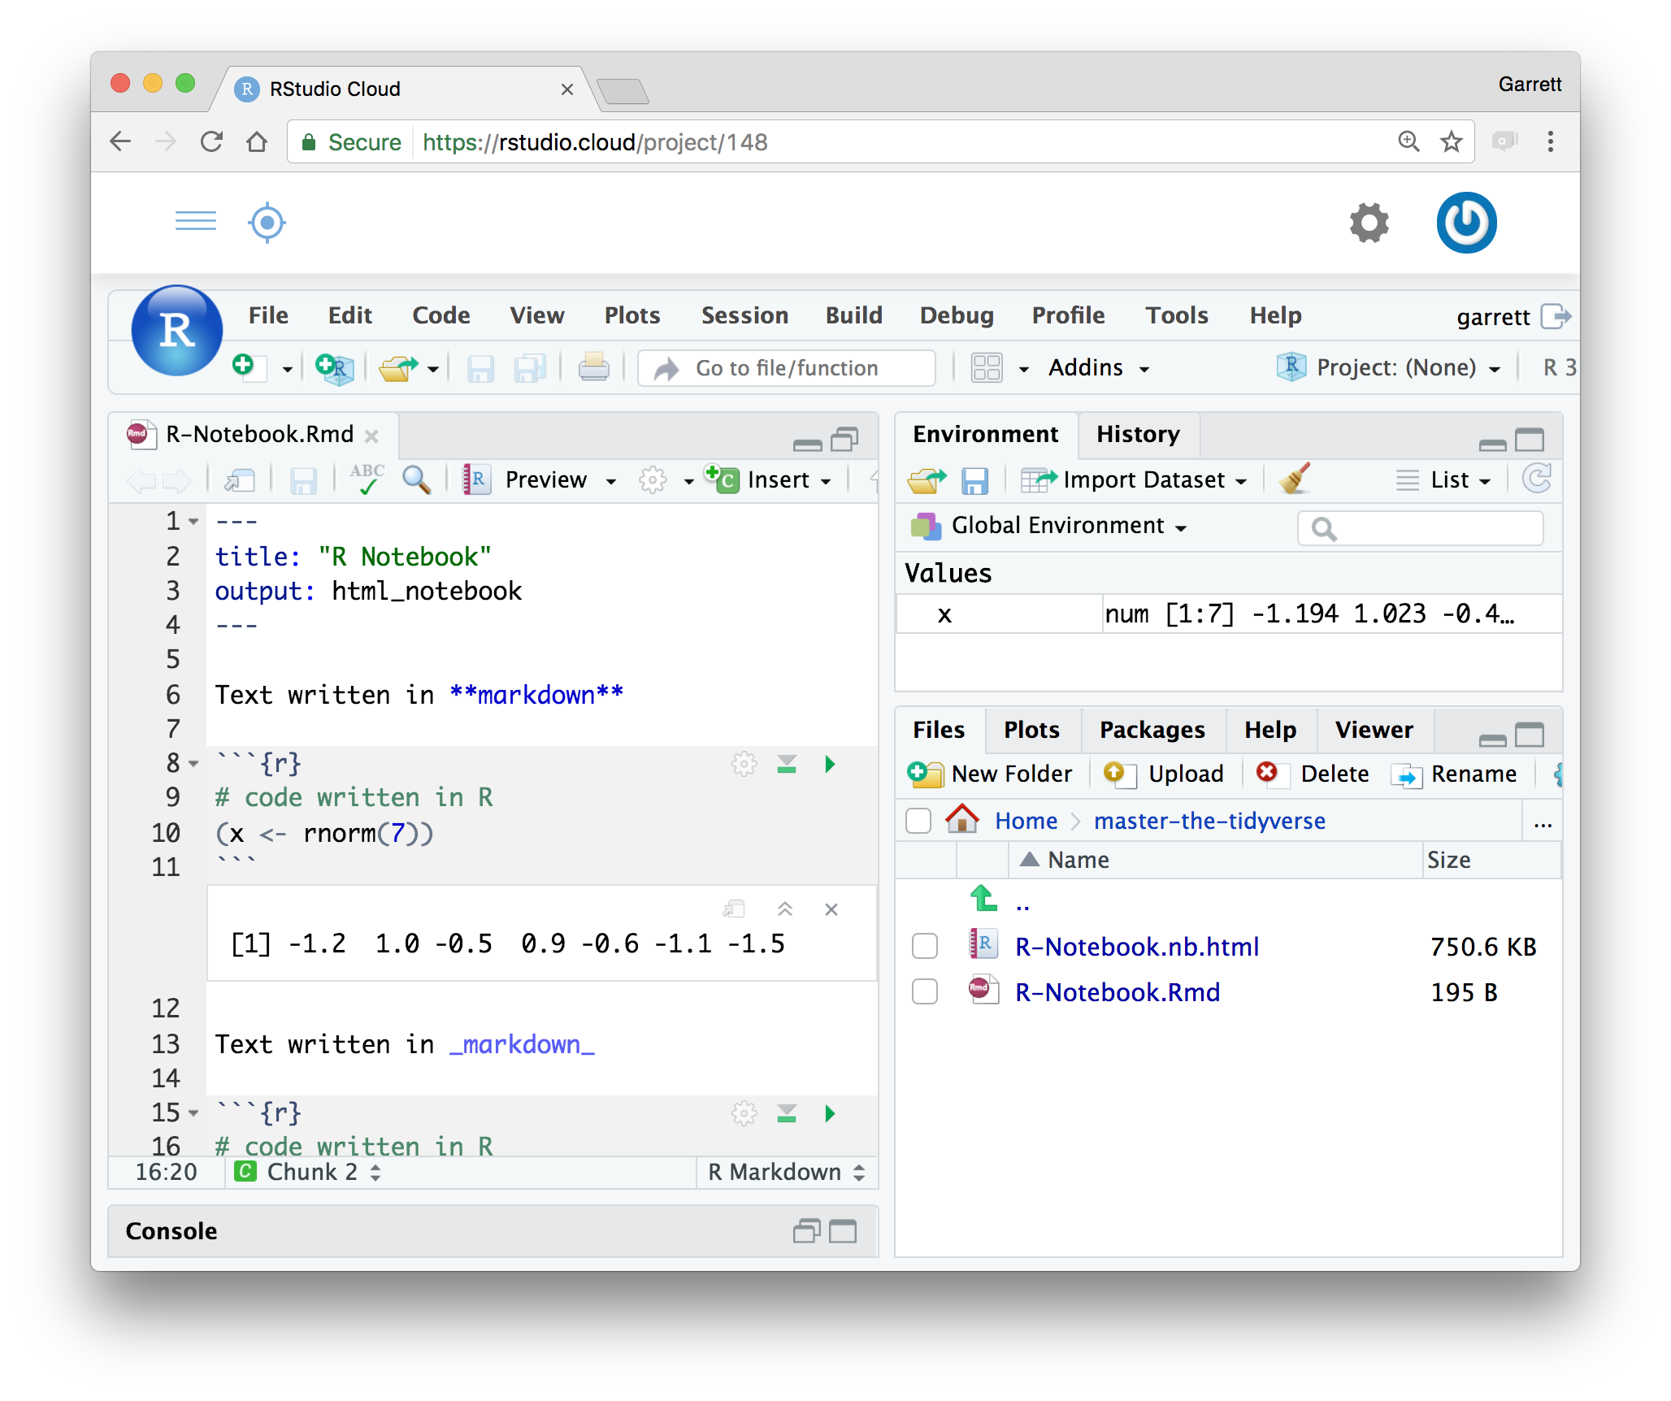
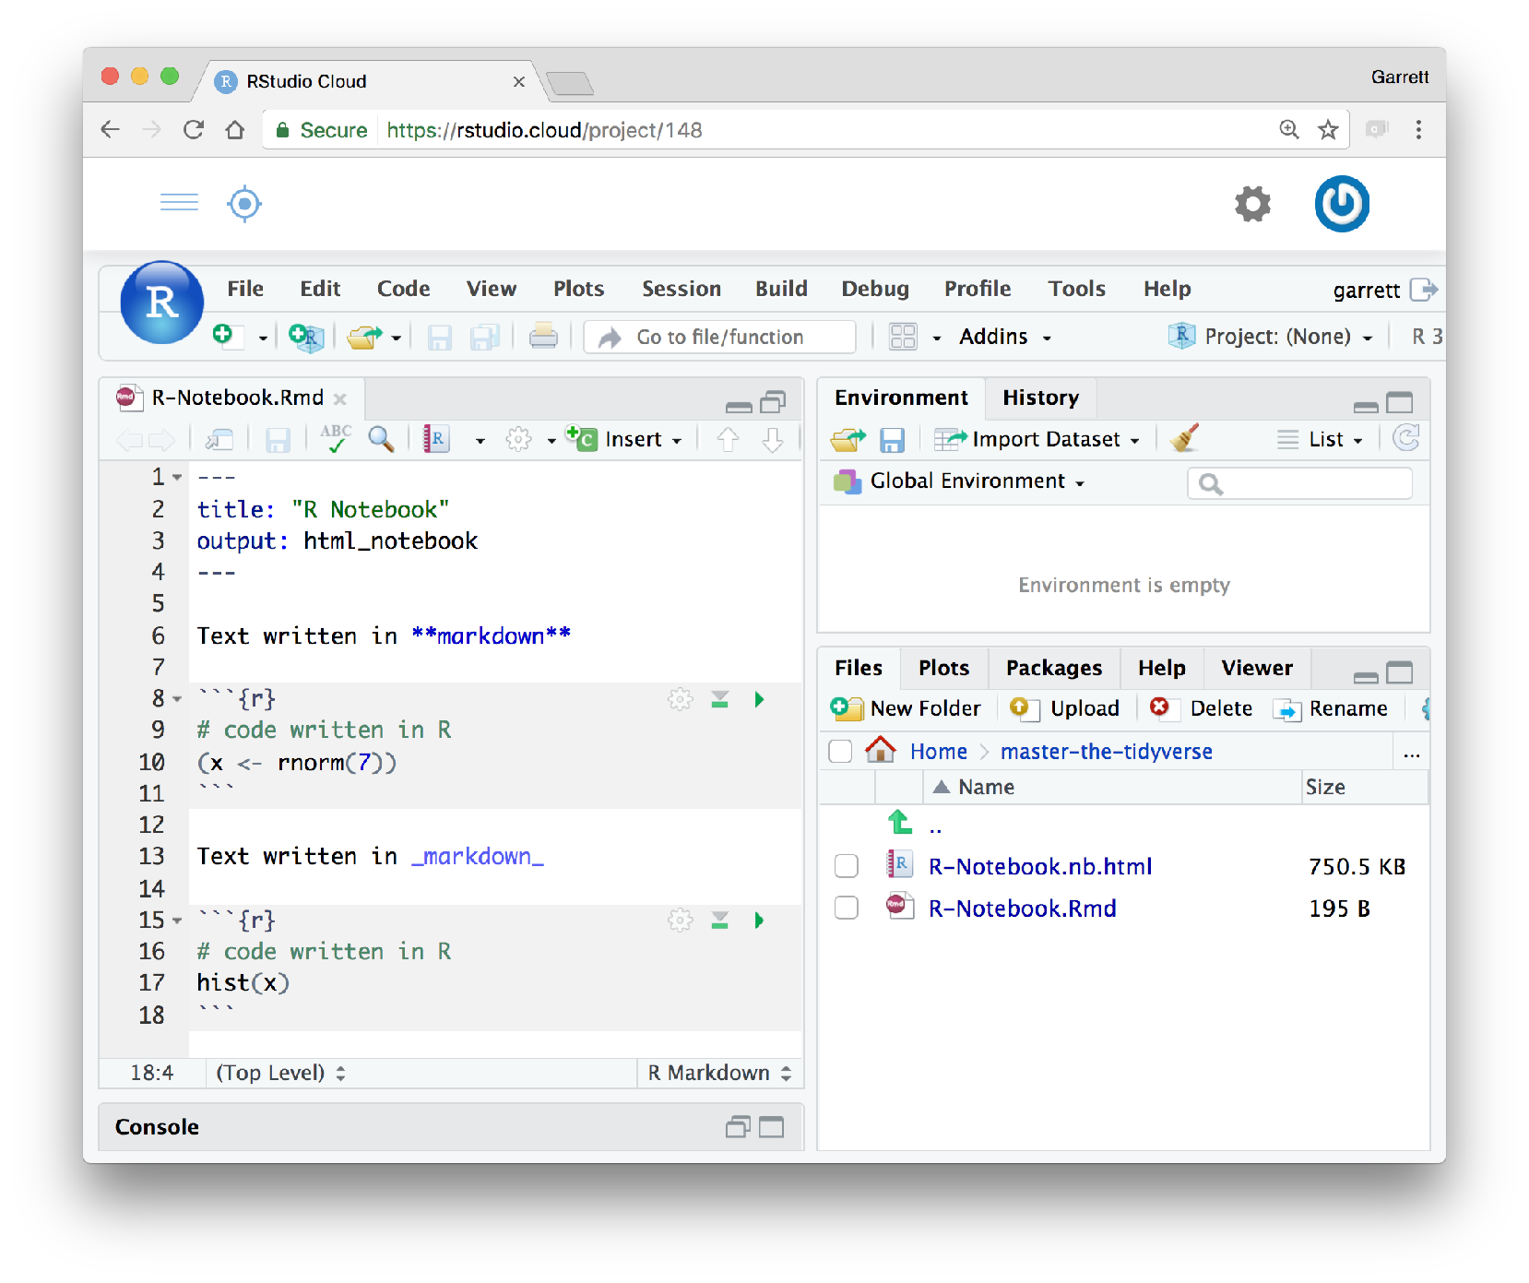
R Markdown
An authoring format for Data Science.
Code goes in a chunk
Click to run code in chunk
Code result
Click on .Rmd file to open notebook

Slide 43
R Packages
Notes:
Raise your hand if you know what an R package is (do or skip the next slide according to the results)

Slide 44
Your Turn
(If you know) explain to your group what an R package is.

Slide 45

help
help
help
pressure | pressure | pressure | pressure
1007 | 1007 | 1007 | 1007
1009 | 1009 | 1009 | 1009
pressure | pressure | pressure
pressure | pressure | pressure
function1()
function2()
function3()
function4()
Notes:
The R language contains thousands of functions, data sets, and help pages.

Slide 46
help
help
help
help
help
help
help
help
help
help
help
help
pressure | pressure | pressure | pressure
1007 | 1007 | 1007 | 1007
1009 | 1009 | 1009 | 1009
pressure | pressure | pressure
pressure | pressure | pressure | pressure
1007 | 1007 | 1007 | 1007
1009 | 1009 | 1009 | 1009
pressure | pressure | pressure
pressure | pressure | pressure | pressure
1007 | 1007 | 1007 | 1007
1009 | 1009 | 1009 | 1009
pressure | pressure | pressure
pressure | pressure | pressure | pressure
1007 | 1007 | 1007 | 1007
1009 | 1009 | 1009 | 1009
pressure | pressure | pressure
pressure | pressure | pressure
pressure | pressure | pressure
pressure | pressure | pressure
pressure | pressure | pressure
function1()
function2()
function3()
function4()
function5()
function6()
function7()
function8()
function9()
functionA()
functionB()
functionC()
functionD()
functionE()
functionF()
functionG()
Base R
Notes:
But you don't get all of the functions, data sets and help pages, when you download R. Instead, R installs a core set known as "base R."

Slide 47
help
help
help
help
help
help
help
help
help
help
help
help
pressure | pressure | pressure | pressure
1007 | 1007 | 1007 | 1007
1009 | 1009 | 1009 | 1009
pressure | pressure | pressure
pressure | pressure | pressure | pressure
1007 | 1007 | 1007 | 1007
1009 | 1009 | 1009 | 1009
pressure | pressure | pressure
pressure | pressure | pressure | pressure
1007 | 1007 | 1007 | 1007
1009 | 1009 | 1009 | 1009
pressure | pressure | pressure
pressure | pressure | pressure | pressure
1007 | 1007 | 1007 | 1007
1009 | 1009 | 1009 | 1009
pressure | pressure | pressure
pressure | pressure | pressure
pressure | pressure | pressure
pressure | pressure | pressure
pressure | pressure | pressure
function1()
function2()
function3()
function4()
function5()
function6()
function7()
function8()
function9()
functionA()
functionB()
functionC()
functionD()
functionE()
functionF()
functionG()
Base R
R Packages
Notes:
The other functions, data sets, and help pages are grouped into collections known as packages that you can choose to download or not download.

Slide 48
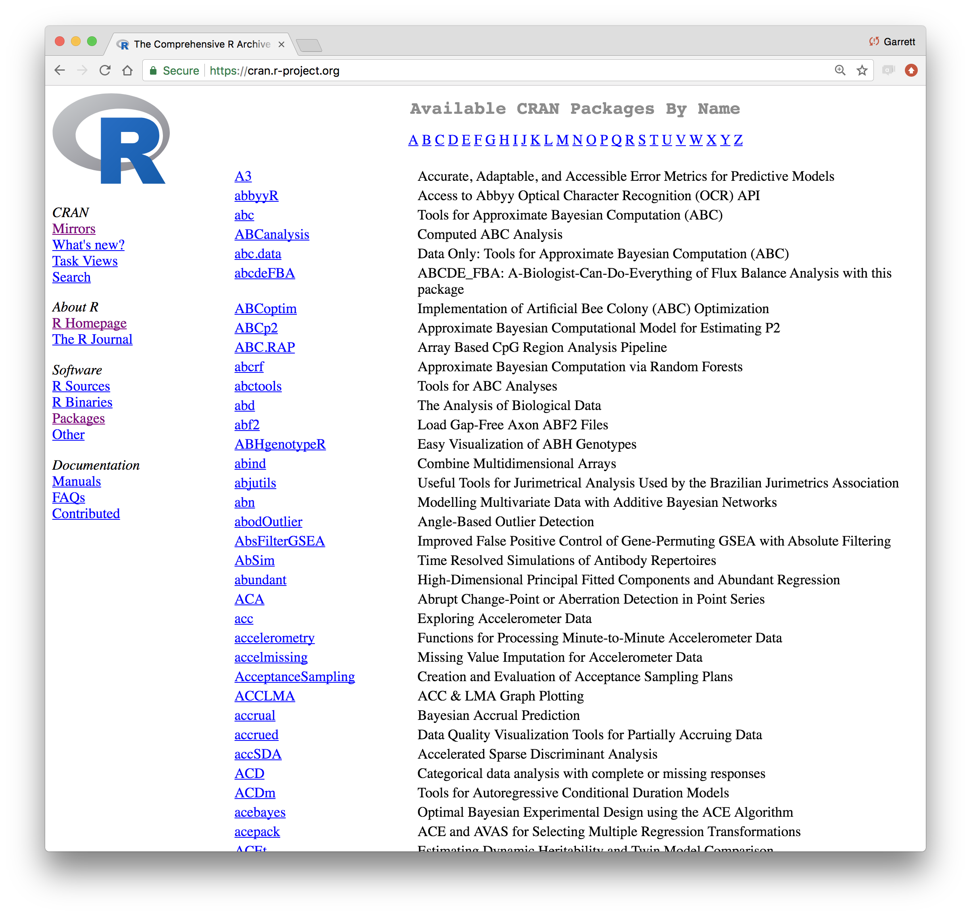
Notes:
Most R packages are stored on CRAN, alongside R. Think of them as optional extensions of the R language.
This organization is great for R in two ways. First, it makes R fast. When you call a function name, R only needs to search through the packages that you have installed and loaded. If R had to search through every function that existed, it would take a long time. (Not to mention that it would take a long time to download all of those functions). Second, it makes it very easy to extend R. If you'd like to add new functions for R users to use, all you need to do is write a package. As of yesterday, there were 12,000 R packages.

Slide 49
14108
packages
in 5/2019
Graph by https://besteamperu.org
Notes:
Most R packages are stored on CRAN, alongside R. Think of them as optional extensions of the R language.
This organization is great for R in two ways. First, it makes R fast. When you call a function name, R only needs to search through the packages that you have installed and loaded. If R had to search through every function that existed, it would take a long time. (Not to mention that it would take a long time to download all of those functions). Second, it makes it very easy to extend R. If you'd like to add new functions for R users to use, all you need to do is write a package. As of yesterday, there were 12,000 R packages.

Slide 50
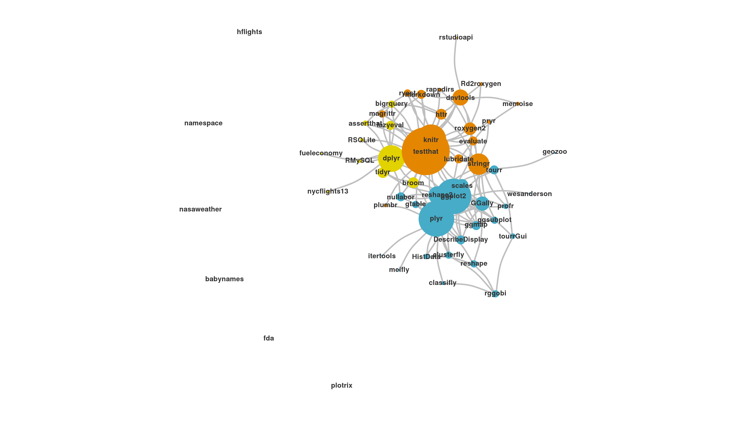
The Tidyverse
A collection of modern R packages that share common philosophies, embed best practices, and are designed to work together.
CC by RStudio
Display by Adolfo A ́lvarez
Notes:
A collection of R packages that are designed to work well together. All of the packages share a common philosophy about how functions should work with each other. And all of the packages are written to support an overarching vision of data science best practices. This network diagram arranges tidyverse packages by their common contributors, which identifies another source of continuity between the packages: they are developed by a coherent group of developers, many of whom are professional R developers who create and maintain the packages as their full time job (not always common with an open source language like R).

Slide 51

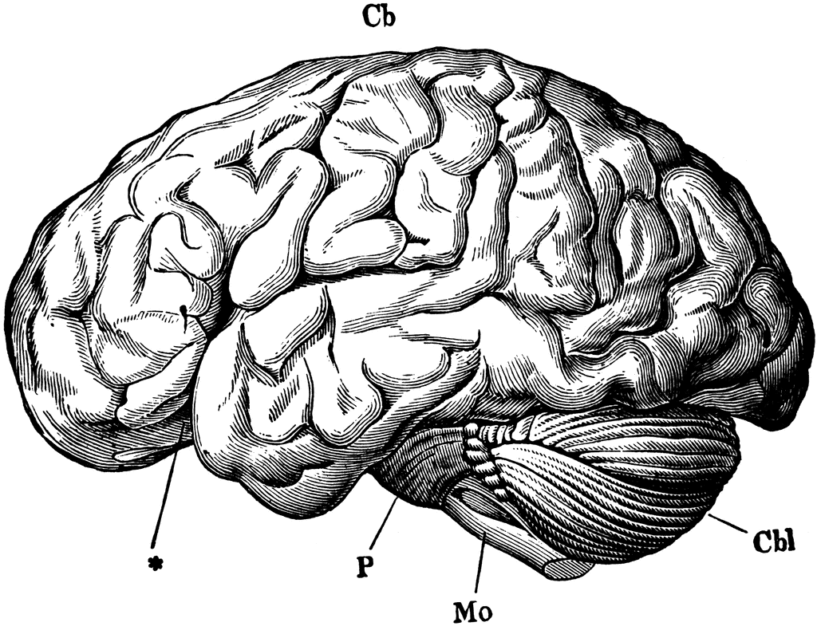
Neocortex
Limbic
System
Reptilian
Brain
Graph by https://besteamperu.org
Notes:
Most R packages are stored on CRAN, alongside R. Think of them as optional extensions of the R language.
This organization is great for R in two ways. First, it makes R fast. When you call a function name, R only needs to search through the packages that you have installed and loaded. If R had to search through every function that existed, it would take a long time. (Not to mention that it would take a long time to download all of those functions). Second, it makes it very easy to extend R. If you'd like to add new functions for R users to use, all you need to do is write a package. As of yesterday, there were 12,000 R packages.

Slide 52
Using packages
1
install.packages("foo")
Downloads files to computer
1 x per computer
Notes:
Before you can use a package, you need to ask R to install the package on your computer. You can do this by opening R and then typing the command: install.packages at the command line. after install.packages, place a pair of parentheses that contain the package name surrounded by quotation marks. R will download the package and install it on your computer. You only need to do this once per package (because after you install it, the package is on your computer. There is no reason to re-download it unless a new version is available).
However, downloading a package isn't the same as using it. If you'd like to use an R package, you need to tell R. You do that by running the command library, again followed by parentheses and the package name. library loads all of the functions, data sets and help pages that come with the package into your R session, where you can use them. If you close R, you'll need to reload the package with library() if you want to use it again.

Slide 53
Pop Quiz!
The tidyverse contains the following packages. How would you install them?
ggplot2
dplyr
tidyr
readr
purrr
tibble
hms
stringr
lubridate
forcats
DBI
haven
httr
jsonlite
readxl
rvest
xml2
modelr
tidyverse

Slide 54
install.packages("ggplot2")
install.packages("dplyr")
install.packages("tidyr")
install.packages("readr")
install.packages("purrr")
install.packages("tibble")
install.packages("hms")
install.packages("stringr")
install.packages("lubridate")
install.packages("forcats")
install.packages("DBI")
install.packages("haven")
install.packages("httr")
install.packages("jsonlite")
install.packages("readxl")
install.packages("rvest")
install.packages("xml2")
install.packages("modelr")
install.packages("broom")

Slide 55
tidyverse
An R package that serves as a short cut for installing and loading the components of the tidyverse.
install.packages("tidyverse")
Notes:
One example of how tidyverse packages are tightly integrated with each other is that there is a package named tidyverse, that installs them all with one command.

Slide 56
install.packages("tidyverse")
does the equivalent of
install.packages("ggplot2")
install.packages("dplyr")
install.packages("tidyr")
install.packages("readr")
install.packages("purrr")
install.packages("tibble")
install.packages("hms")
install.packages("stringr")
install.packages("lubridate")
install.packages("forcats")
install.packages("DBI")
install.packages("haven")
install.packages("httr")
install.packages("jsonlite")
install.packages("readxl")
install.packages("rvest")
install.packages("xml2")
install.packages("modelr")
install.packages("broom")
I've already installed all of
the packages you need

Slide 57
Using packages
1
2
install.packages("foo")
library("foo")
Downloads files to computer
Loads package
1 x per computer
1 x per R Session
Notes:
Before you can use a package, you need to ask R to install the package on your computer. You can do this by opening R and then typing the command: install.packages at the command line. after install.packages, place a pair of parentheses that contain the package name surrounded by quotation marks. R will download the package and install it on your computer. You only need to do this once per package (because after you install it, the package is on your computer. There is no reason to re-download it unless a new version is available).
However, downloading a package isn't the same as using it. If you'd like to use an R package, you need to tell R. You do that by running the command library, again followed by parentheses and the package name. library loads all of the functions, data sets and help pages that come with the package into your R session, where you can use them. If you close R, you'll need to reload the package with library() if you want to use it again.

Slide 58

install.packages("tidyverse")
library("tidyverse")
does the equivalent of
does the equivalent of
install.packages("ggplot2")
install.packages("dplyr")
install.packages("tidyr")
install.packages("readr")
install.packages("purrr")
install.packages("tibble")
install.packages("stringr")
install.packages("forcats")
install.packages("lubridate")
install.packages("hms")
install.packages("DBI")
install.packages("haven")
install.packages("httr")
install.packages("jsonlite")
install.packages("readxl")
install.packages("rvest")
install.packages("xml2")
install.packages("modelr")
install.packages("broom")
library("ggplot2")
library("dplyr")
library("tidyr")
library("readr")
library("purrr")
library("tibble")
library("stringr")
library("forcats")
Notes:
The core tidyverse packages are the ones that you are likely to use in every analysis. You need to load non-core tidyverse packages individually with library()

Slide 59
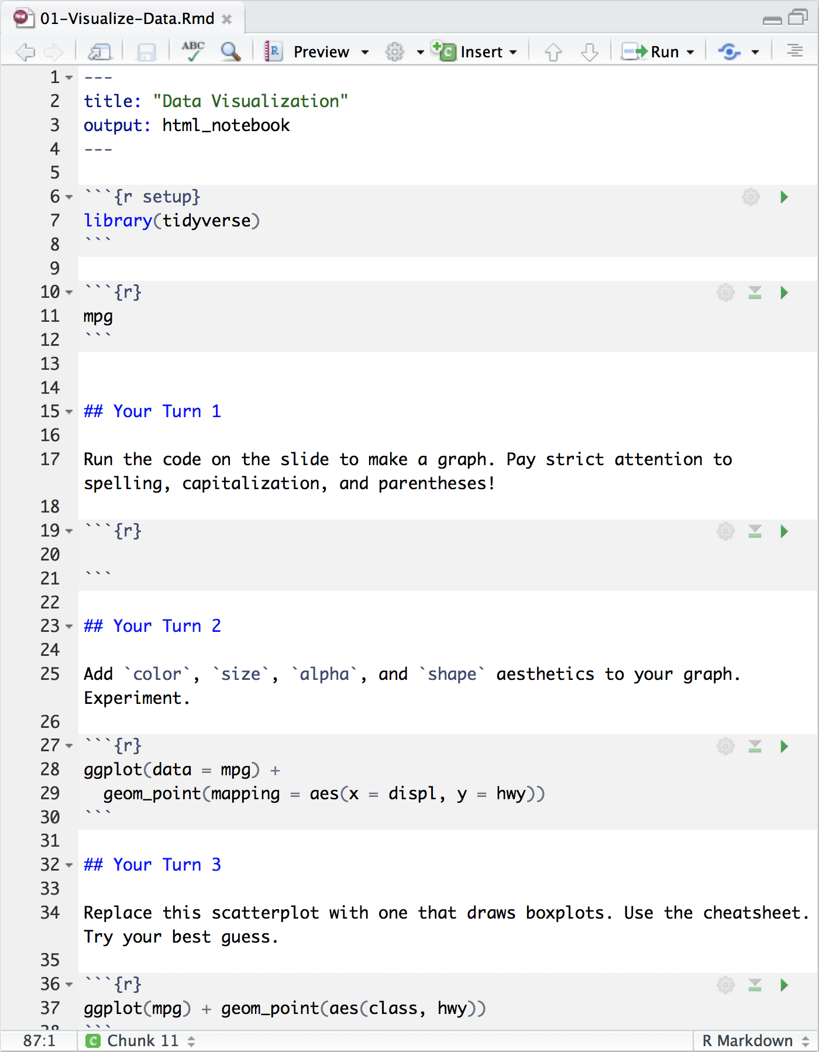
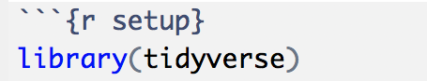
Setup
The setup chunk is always run once before anything else
chunk labels are optional, the setup label is special

Slide 60
Your Turn
Add a setup chunk to the top of 01-RMarkdown-Exercises.Rmd. Use it to load the tidyverse package, then uncomment and run the ggplot2 chunk at the bottom of your file.
chunk labels are optional, the setup label is special

Slide 61
Neocortex
Limbic
System
Reptilian
Brain
Graph by https://besteamperu.org
Notes:
Most R packages are stored on CRAN, alongside R. Think of them as optional extensions of the R language.
This organization is great for R in two ways. First, it makes R fast. When you call a function name, R only needs to search through the packages that you have installed and loaded. If R had to search through every function that existed, it would take a long time. (Not to mention that it would take a long time to download all of those functions). Second, it makes it very easy to extend R. If you'd like to add new functions for R users to use, all you need to do is write a package. As of yesterday, there were 12,000 R packages.

Slide 62
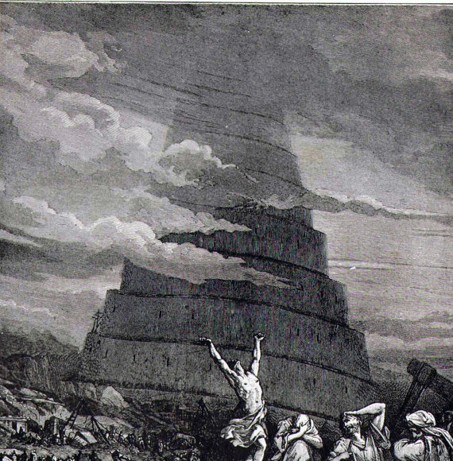
Notes:
In short, R has a Tower of Babel problem. Different users like to do different things in different ways. If we cover something that you already know how to do in a different way, you don't need to change. In most cases, I think the tidyverse methods will provide a slight advantage (but the key word here is slight, and the advantage is often in the ease of learning it). If you already know how to do something well, there's no need to retrain yourself. That said, take a look at what I'm teaching and see what you think.

Slide 63
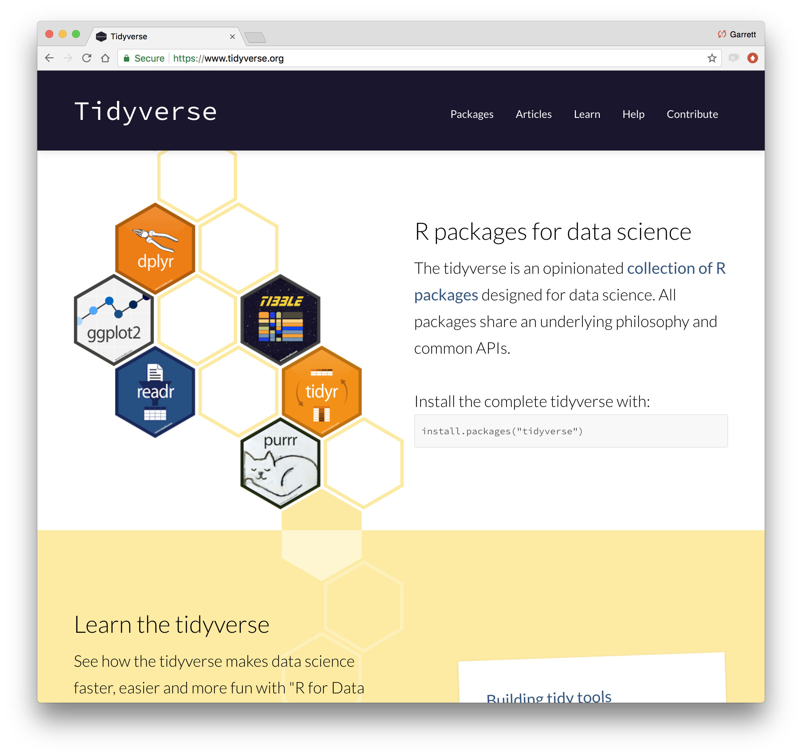
tidyverse.org
Notes:
Perhaps because of this, the tidyverse functions are extremely well documented and easy to learn. And since they are designed to work in similar ways, learning one function teaches you a lot about using the rest.

Slide 64

Your Turn 0
Navigate up to the 02-Visualize folder.
Open 02-Visualize-Exercises.Rmd
Add a setup chunk that loads the tidyverse packages.

